Slide 1



Slide 2
Light Lesson 6 Light to the World Through Service: Towel Bearers

Slide 3
Our Light
Luke 11:33-36: "No man, when he hath lighted a candle, putteth it in a secret place, neither under a bushel, but on a candlestick, that they which come in may see the light. The light of the body is the eye: therefore when thine eye is single, thy whole body also is full of light; but when thine eye is evil, thy body also is full of darkness. Take heed therefore that the light which is in thee be not darkness. If thy whole body therefore be full of light, having no part dark, the whole shall be full of light, as when the bright shining of a candle doth give thee light." Clearly, part of the Christians walk in the light is to share that light through good works to glorify God.
Clearly, part of the Christian's walk in the light is to share that light through good works to glorify God.

Slide 4

Introduction: Expressions
Poor prior preparation produce pitiful performances
Success starts when those warm, warm feet hit the cold, cold floor.
Life is the choices you make.
Excellence is a choice
There is never a right time to do the wrong thing. There is never a wrong time to do the right thing.
Better to aim high and miss than low an hit your target.
Never educate yourself away from God.
Never let your schooling get in the way of your education.
If momma ain’t happy, nobody is happy.
If it is worth doing, it is worth doing well.
Actions speak louder than words.
Best thing since sliced bread
You can’t judge a book by its cover.
Don’t cry over spilt milk.
Don’t put all your eggs in one basket.
Hoe your own row of corn.
Don’t change boyfriends like you change shirts.
Possession is 9/10th of the law
YOUR SERVANT TOWEL SHOULD BE HUGE AND WELL USED

Slide 5
Introduction: Philippians 2:4-9
(ESV) 4 Let each of you look not only to his own interests, but also to the interests of others. 5 Have this mind among yourselves, which is yours in Christ Jesus, 6 who, though he was in the form of God, did not count equality with God thing to be grasped, 7 but made himself nothing, taking the form of a servant, being born in the likeness of men. 8 And being found in human form, he humbled himself by becoming obedient to the point of death, even death on a cross. 9 Therefore God has highly exalted him and bestowed on him the name that is above every name,
Notes:
Jesus demonstrated service and humility while asking the same of His followers. Philippians 2:4-9 (ESV) reads, "Let each of you look not only to his own interests, but also to the interests of others. Have this mind among yourselves, which is yours in Christ Jesus, who, though he was in the form of God, did not count equality with God a thing to be grasped, but made himself nothing, taking the form of a servant, being born in the likeness of men. And being found in human form, he humbled himself by becoming obedient to the point of death, even death on a cross. Therefore, God has highly exalted him and bestowed on him the name that is above every name." What an Example! “IS YOUR SERVANT TOWEL HUGE AND WELL USED?”

Slide 6
Introduction: Frequent Temptations
Henry Nouwen, "In The Name of Jesus"
To be self-sufficient and self-reliant
To be spectacular… having a celebrity mentality.
To want control and power
“Jesus is coming. Look busy.”
Notes:
Henry Nouwen’s “In the Name of Jesus” lists three frequent temptations for humans. The first temptation is the desire to be self-sufficient and self-reliant. Many today feel they can handle things themselves and do not need anyone’s help. The second temptation is the need to be spectacular with a celebrity mentality. Many people today draw attention to themselves wanting glory for themselves. The third temptation is the want for control and power. Some people have a strong desire to be the one in charge or in control of everything.
In contrast, we should not try to control everything. Servants of the Lord cannot meet most folks’ expectations. Therefore, we cannot concern ourselves with who gets the credit but instead seek to give God the glory. As a servant, we should work together for the Lord’s kingdom. Whenever we serve, we should seek to do more with others as a team. However, pride and the big “I” are a temptation. As a result, we must remember ensembles are usually better than solos.
Servants should model the Master. Whenever Christians serve, an emphasis on quality over quantity is important. The numbers game is often a temptation to a person’s pride. Years ago, there were magnet buttons with the phrase "Jesus is coming. Look busy!" written on them. This probably represents a fourth temptation of hypocrisy and false show.

Slide 7
Introduction: Servants of God
Col 3 :22-24 Servants, obey in all things your masters according to the flesh; not with eyeservice, as menpleasers; but in singleness of heart, fearing God: 23And whatsoever ye do, do it heartily, as to the Lord, and not unto men; 24Knowing that of the Lord ye shall receive the reward of the inheritance: for ye serve the Lord Christ
Notes:
Servants of God should demonstrate excellence as working for the Lord instead of eyeservice. Colossians 3:22-24 instructs, “Servants, obey in all things your masters according to the flesh; not with eyeservice, as menpleasers; but in singleness of heart, fearing God: And whatsoever ye do, do it heartily, as to the Lord, and not unto men; Knowing that of the Lord ye shall receive the reward of the inheritance: for ye serve the Lord Christ.” In addition, Proverbs 22:9 encourages, "He that hath a bountiful eye shall be blessed; for he giveth of his bread to the poor." “IS YOUR SERVANT TOWEL HUGE AND WELL USED?”

Slide 8
Introduction: Greatness
Matthew 20:25-28
25 But Jesus called them to him and said, "You know that the rulers of the Gentiles lord it over them, and their great ones exercise authority over them. 26 It shall not be so among you. But whoever would be great among you must be your servant,c 27 and whoever would be first among you must be your slave, 28 even as the Son of Man came not to be served but to serve, and to give his life as a ransom for many."
Notes:
In Matthew 20:25-28, after the mother of the sons of Zebedee asks for positions for her sons, Jesus teaches on greatness. “But Jesus called them to him and said, ‘You know that the rulers of the Gentiles lord it over them, and their great ones exercise authority over them. It shall not be so among you. But whoever would be great among you must be your servant, and whoever would be first among you must be your slave, even as the Son of Man came not to be served but to serve, and to give his life as a ransom for many.’ " Similarly, Luke 18:14 teaches, “For everyone who exalts himself will be humbled, but the one who humbles himself will be exalted.” This is such a contrast to how the world thinks of greatness.

Slide 9
Introduction: Worldly Thinking
The Greeks said, be wise, know yourself
The Romans said, be strong, discipline yourself.
Hollywood says, be sensuous, enjoy yourself
Education says, be resourceful, expand yourself,
Psychology says, be confident, assert yourself
Materialism says, be satisfied, please yourself
Pride says, be superior, promote yourself.
Christ says, be a servant, humble yourself. FOCUSING ON OTHERS
Notes:
The world's way of becoming great is much different than God's. The Word of God teaches greatness is not in a position, a title, an accomplishment, or earthly gain, but it is in becoming a servant. Jesus Himself gave an example of servanthood by humbling Himself to death on a cross. He did not have to do. Two verses later, we read Jesus came to earth not to be served but to serve. This concept of greatness is backward from a worldly perspective. There are many concepts in the Scriptures that are backward from the worldly viewpoint. “To gain your life, you must lose it.” “To receive, one must give.” “To live is Christ and to die is gain.” “To be victorious in battle, one must let God do the fighting.” “To be great, one must first be a servant.” This is not the way the world thinks.
Worldly thinking includes various thoughts on greatness. The Greeks said, “Be wise, know yourself.” The Romans said, “Be strong, discipline yourself.” Hollywood says, “Be sensuous, enjoy yourself.” Education says, “Be resourceful, expand yourself.” Psychology says, “Be confident, assert yourself.” Materialism says, “Be satisfied, please yourself.” Pride says, “Be superior, promote yourself.” Christ says, be a servant, humble yourself by focusing on serving others.
In contrast, consider Jesus. He had no servants yet was called “Master.” He had no published CV or diplomas yet was called “Teacher.” He had no medicine, yet he is called a Healer. He had no army yet kings feared Him. He had no military battles with victories, yet he conquered the world. Jesus’ demonstration of leadership through service is powerful. IS YOUR SERVANT TOWEL HUGE AND WELL USED?”

Slide 10
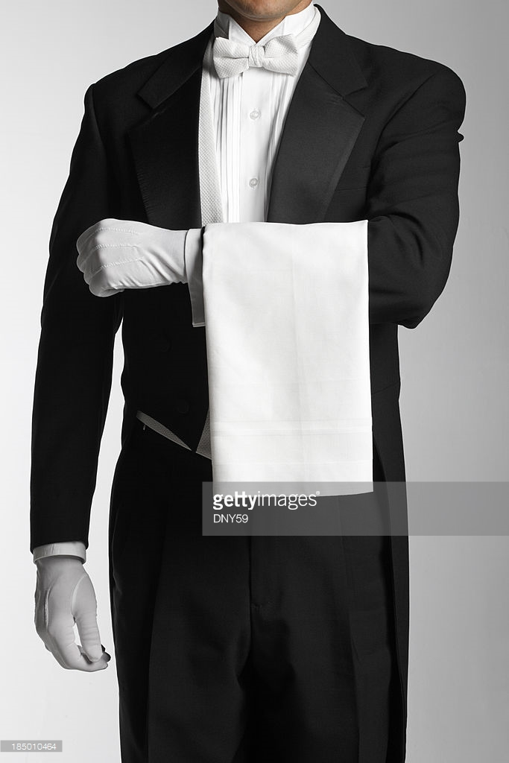
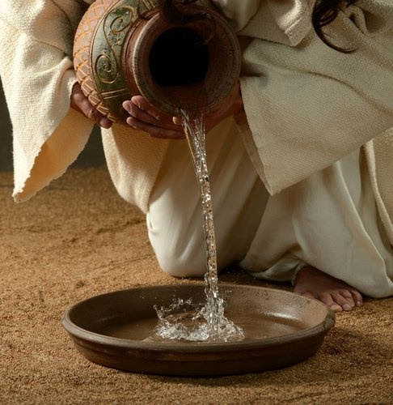
Towel Servant
"Service banishes us to the mundane, the ordinary, the trivial.... Therefore the spiritual authority of Jesus is an authority not found in a position or title, but in a towel." - R. Foster
Notes:
When Jesus washed the disciples’ feet in John 13:4-5, he demonstrated leadership with a towel. When we hold a towel in our hands, we might reflect on Jesus’ example. In the ancient world, there was a custom of washing dirty feet. Often it was a bottom rung servant’s job. It was a dirty and necessary thing as people traveled a great distance by walking. A servant was a towel bearer. A towel bearer is one who is ready, willing, able and prepared to serve. In the end, the servant’s towel should be huge and well used.
We can explore how this is true in our physical life, as well as, spiritually. Richard Foster, a Quaker, expressed the idea by writing, "Service banishes us to the mundane, the ordinary, the trivial...Therefore, the spiritual authority of Jesus is an authority not found in a position or title, but in a towel." Towel bearers are servants!

Slide 11

Towel Bearers Find Fulfillment
In being obedient to God
1 Sam 3:10And the LORD came, and stood, and called as at other times, Samuel, Samuel. Then Samuel answered, Speak; for thy servant heareth.
Notes:
Finding Fulfillment as A Towel Bearer in Service
Christians are towel bearers and servants in the Kingdom of God. Towel bearers find fulfillment in this role in several ways. First, towel Bearers find fulfillment in being obedient to God. One might think of young Samuel attending to Eli as an example of fulfillment in serving. Samuel thought Eli was calling, but it was the Lord. “And the LORD came, and stood, and called as at other times, Samuel, Samuel. Then Samuel answered, Speak; for thy servant heareth” (1 Sam 3:10).
It is Samuel’s enthusiastic ready to serve attitude that the Christian should have today. The specifics of the assignment should not be key. Christians should have a ready to serve attitude. God can use a person in prison as he did Joseph or a king as in David. God also used the blind man in John 9 to His glory, not because of his or his parent’s sin. Further, the assignment or one’s status does not matter. Do we want latrine duty or to be the personal envoy? We should have the attitude of being ready to go in whatever is needed! The assignment should not matter! Servants find joy in being obedient to God. It is not what God has us do as much as we do what God wants.

Slide 12

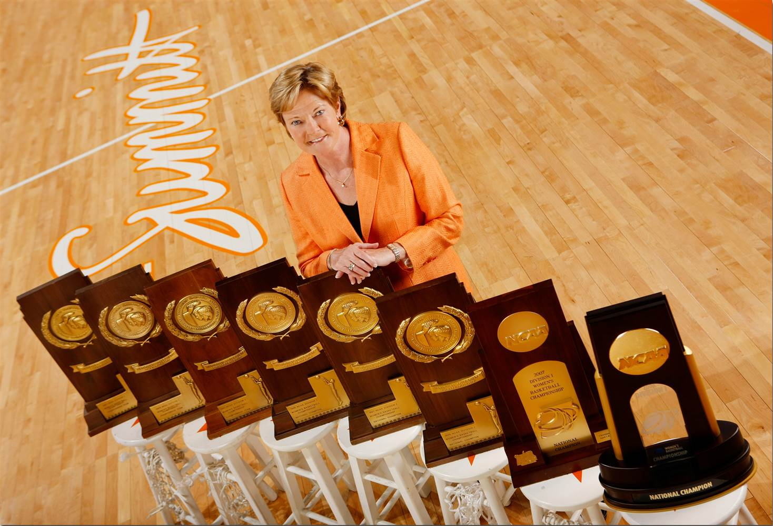

Mops and Brooms
Notes:
Failing to understand His righteousness, folks are too often ready to substitute their understanding for God’s. He calls the children of Light to be servants (Ephesians 5:8, Col. 1:12). Dave Thomas of Wendy's is famous for appearing in corporate materials wearing an apron and mopping floors. He defended his appearance in the corporate materials. It was not a photo-op or a stunt. He had learned his craft at an upscale restaurant. Waiters had to apprentice for a job. Waiters made their living solely on tips. They operated as a team. This was where he developed his MBA program. He called it a “Mop Bucket Attitude.” Similarly, servants of God must make sure their servant towel is bigger than their ego. “[Speaking of servant towels],
ego is the anesthesia that deadens the pain of stupidity” (Rick Rigsby). Pride is the burden of a foolish person.
At this writing, basketball’s two most winning coaches are John Wooden and Pat Head Summitt. Even after having won multiple national championships John Wooden took a broom to the gym floor at UCLA. He impacted people by serving using a hard work attitude. Christians must get their broom out to impact people. Mops and brooms influence people! Christians attract people to God's kingdom through service.
Similarly, Pat Head Summitt was another great basketball coach. She had a reputation for driving her players hard to excellence. She started her program when woman's basketball was an afterthought at the college level. She developed her team, drove the van, and washed the uniforms. Her hard work created and built the program. Many would even say Coach Summitt’s woman's basketball program helped grow women’s college basketball. By working hard, she built the program others would seek to rival. Her 1,098 wins and many national championships remain a standard of excellence. A bronze statue is outside the basketball arena at the University of Tennessee where the court is named in her honor. Examples of service can inspire as Wooden and Summitt illustrate, but even more so in God's kingdom. People are drawn to strength at the bottom when one has humbled themselves before God. Thus, if you cannot use a mop, then you might try the broom. If a mop and broom do not work, then try a towel! “IS YOUR SERVANT TOWEL HUGE AND WELL USED?”

Slide 13
Towel Bearers Find Fulfillment
By taking on the Nature of a Servant, Imitating the Divine Nature
John 13:4-17 He riseth from supper, and laid aside his garments; and took a towel, and girded himself. After that he poureth water into a bason, and began to wash the disciples' feet, and to wipe them with the towel wherewith he was girded. Then cometh he to Simon Peter: and Peter saith unto him, Lord, dost thou wash my feet? Jesus answered and said unto him, What I do thou knowest not now; but thou shalt know hereafter. Peter saith unto him, Thou shalt never wash my feet. Jesus answered him, If I wash thee not, thou hast no part with me. Simon Peter saith unto him, Lord, not my feet only, but also my hands and my head. Jesus saith to him, He that is washed needeth not save to wash his feet, but is clean every whit: and ye are clean, but not all. For he knew who should betray him; therefore said he, Ye are not all clean. So after he had washed their feet, and had taken his garments, and was set down again, he said unto them, Know ye what I have done to you? Ye call me Master and Lord: and ye say well; for so I am. If I then, your Lord and Master, have washed your feet; ye also ought to wash one another's feet. For I have given you an example, that ye should do as I have done to you.Verily, verily, I say unto you, The servant is not greater than his lord; neither he that is sent greater than he that sent him. If ye know these things, happy are ye if ye do them.
Notes:
Second, servant towel bearers find fulfillment by taking on the nature of a servant while imitating the divine nature, specifically humility. The fact that Jesus humbled Himself and made himself nothing tells us He took on the mindset of a servant. In John 13, Jesus not only spoke about being a servant, but He showed what it is to be a servant. As you read verse 3, you understand Jesus has power. With meekness (strength under control), he became a servant. This is a lesson of love. Verses 4-17 read, “He riseth from supper, and laid aside his garments; and took a towel, and girded himself. After that he poureth water into a basin, and began to wash the disciples' feet, and to wipe them with the towel wherewith he was girded. Then cometh he to Simon Peter: and Peter saith unto him, Lord, dost thou wash my feet? Jesus answered and said unto him, What I do thou knowest not now; but thou shalt know hereafter. Peter saith unto him, Thou shalt never wash my feet. Jesus answered him, If I wash thee not, thou hast no part with me. Simon Peter saith unto him, Lord, not my feet only, but also my hands and my head. Jesus saith to him, He that is washed needeth not save to wash his feet, but is clean every whit: and ye are clean, but not all. For he knew who should betray him; therefore said he, Ye are not all clean. So after he had washed their feet, and had taken his garments, and was set down again, he said unto them, Know ye what I have done to you? Ye call me Master and Lord: and ye say well; for so I am. If I then, your Lord and Master, have washed your feet; ye also ought to wash one another's feet. For I have given you an example, that ye should do as I have done to you. Verily, verily, I say unto you, The servant is not greater than his lord; neither he that is sent greater than he that sent him. If ye know these things, happy are ye if ye do them.” The Master of the universe humbled Himself to wash dirty feet. He served using His towel! “IS YOUR SERVANT TOWEL HUGE AND WELL USED?”

Slide 14
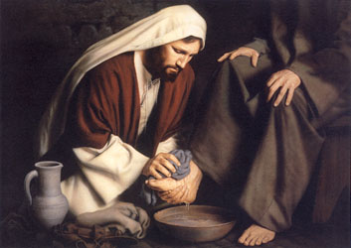
Towel Bearers Find Fulfillment
By taking on the Nature of a Servant, Imitating the Divine Nature
Notes:
Christians are not greater than their Master. If we are going to do a job, then we should do it right. Sometimes a we try to use past failures to excuse ourselves. However, past failures are another expression for learning opportunity. Christians must seek God’s wisdom because no one is going to be smarter than God no matter how much we try to justify ourselves. The spiritually minded person builds a life on Christ that stands in the storms of life. If the Son of God served, then the children of Light should follow that example (1 Thes 5:5).

Slide 15

Towel Bearers Find Fulfillment
In Taking Time to Serve
Col 3:17 And whatsoever ye do in word or deed, do all in the name of the Lord Jesus, giving thanks to God and the Father by him.
Col 3:23-24 And whatsoever ye do, do it heartily, as to the Lord, and not unto men; Knowing that of the Lord ye shall receive the reward of the inheritance: for ye serve the Lord Christ.
Notes:
Third, servant towel bearers find fulfillment in taking time to serve. Colossians 3:17 teaches, "And whatsoever ye do in word or deed, do all in the name of the Lord Jesus, giving thanks to God and the Father by him." Verses 23-24 read, "And whatsoever ye do, do it heartily, as to the Lord, and not unto men; Knowing that of the Lord ye shall receive the reward of the inheritance: for ye serve the Lord Christ." When Christians are willing to use their precious time to minister to the needs of others, then they find fulfillment in service to God.
Everyone has the same amount of time today. Everyone is busy most days with work, school, children, home, etc. Many are overwhelmed in that process. Sometimes, folks are too busy to serve others because they forget to allow for such things. It seems the more rushed we are, the more likely we cannot help those in need along our path. Everyone is busy. Everyone has very busy schedules. However, when we take the time to minister to others, God is glorified. It is difficult in a self-centered world to remember: “It is not all about you, but God!” If we were making a list to encourage our children, we might write: Be careful of too many commitments. Time management is hard. Serving others is God's definition of greatness. The servant towel lights the way for people to Christ. “IS YOUR SERVANT TOWEL HUGE AND WELL USED IN GOD'S KINGDOM?”

Slide 16
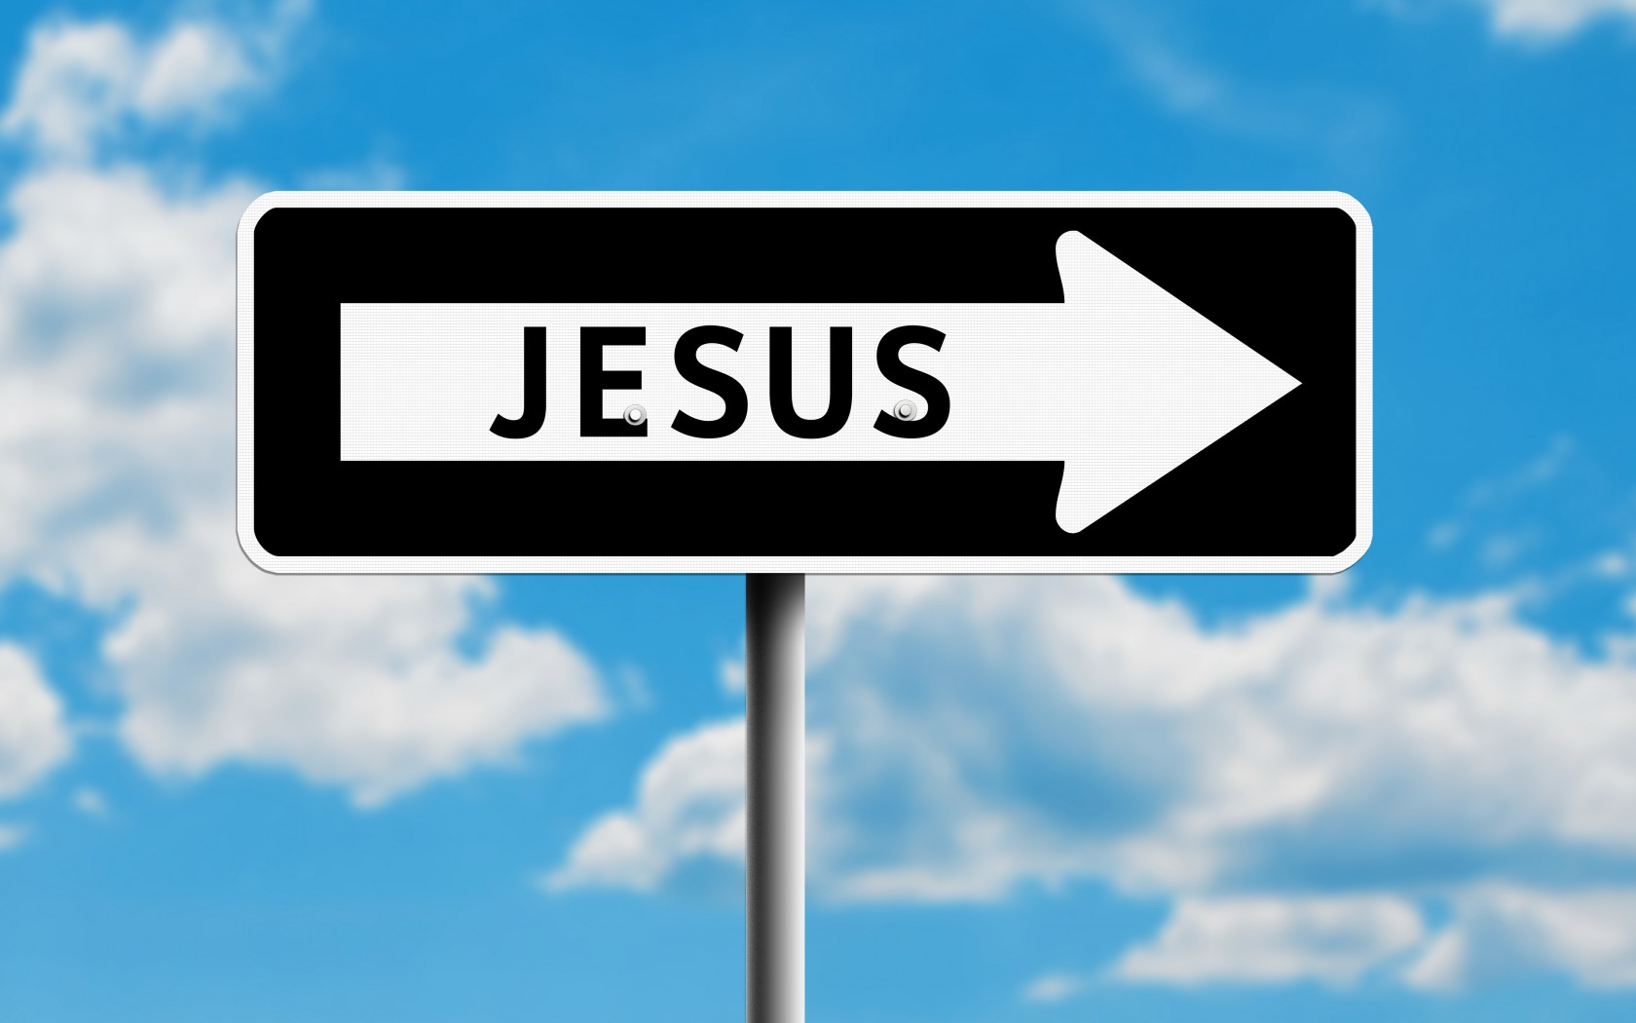
Towel Bearers Find Fulfillment
In Pointing People to Jesus
2 Corinthians 4:5-7 " For we preach not ourselves, but Christ Jesus the Lord; and ourselves your servants for Jesus' sake. For God, who commanded the light to shine out of darkness, hath shined in our hearts, to give the light of the knowledge of the glory of God in the face of Jesus Christ. But we have this treasure in earthen vessels, that the excellency of the power may be of God, and not of us.
Notes:
Fourth, servant towel bearers find fulfillment in pointing people to Jesus. In essence, towel bearers reflect and carry God's light in service to a dark world. 2 Corinthians 4:5-7 explains," For we preach not ourselves, but Christ Jesus the Lord; and ourselves your servants for Jesus' sake. For God, who commanded the light to shine out of darkness, hath shined in our hearts, to give the light of the knowledge of the glory of God in the face of Jesus Christ. But we have this treasure in earthen vessels, that the excellency of the power may be of God, and not of us." Towel bearers represent Jesus Christ to the people whom they serve.

Slide 17
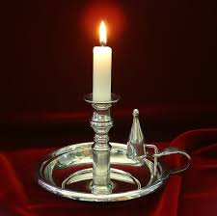
Towel Bearers Find Fulfillment
In Pointing People to Jesus
MATTHEW 5:14-16 Ye are the light of the world. A city that is set on an hill cannot be hid. Neither do men light a candle, and put it under a bushel, but on a candlestick; and it giveth light unto all that are in the house. Let your light so shine before men, that they may see your good works, and glorify your Father which is in heaven.
Notes:
Jesus explained about the child of God's role in Matthew 5:14-16, "Ye are the light of the world. A city that is set on an hill cannot be hid. Neither do men light a candle, and put it under a bushel, but on a candlestick; and it giveth light unto all that are in the house. Let your light so shine before men, that they may see your good works, and glorify your Father which is in heaven." As Christ's workmanship, Christians are told they are created unto good works (Eph 2:10; 2 Tim 3:17). The reason for service is to glorify God. Reflecting God's light and love is the goal of every towel bearer; so, they might point others to God and Christ.
Many people in the world today are tired of hearing people talk about Jesus or calling themselves “Christians.” They want to see someone who shows they are a Christian. The way we show our faith is by being a servant. It is one of those expressions; seeing is believing. “IS YOUR SERVANT TOWEL HUGE AND WELL USED?”

Slide 18
Towel Bearers Find Fulfillment
In God’s Promise To Reward Them
Mt 25:21 His lord said unto him, Well done, thou good and faithful servant: thou hast been faithful over a few things, I will make thee ruler over many things: enter thou into the joy of thy lord.
Mt 25:26-30 His lord answered and said unto him, Thou wicked and slothful servant, thou knewest that I reap where I sowed not, and gather where I have not strawed: Thou oughtest therefore to have put my money to the exchangers, and then at my coming I should have received mine own with usury. Take therefore the talent from him, and give it unto him which hath ten talents. For unto every one that hath shall be given, and he shall have abundance: but from him that hath not shall be taken away even that which he hath. And cast ye the unprofitable servant into outer darkness: there shall be weeping and gnashing of teeth.
Notes:
Fifth, servant towel bearers find fulfillment in God's promise to reward them. It is not that one earns heaven; for those saved are saved by God's grace. With work, there is a need for patience. Weariness in our service can come from the need to be renewed from an eternal perspective.
In the parable of the talents in Matthew 25, the five and two talents persons were told, "His lord said unto him, Well done, thou good and faithful servant: thou hast been faithful over a few things, I will make thee ruler over many things: enter thou into the joy of thy lord (Matthew 25:21)." However, the one talent person received another response in Matthew 25:26-30. "His lord answered and said unto him, Thou wicked and slothful servant, thou knewest that I reap where I sowed not, and gather where I have not strawed: Thou oughtest therefore to have put my
money to the exchangers, and then at my coming I should have received mine own with usury. Take therefore the talent from him, and give it unto him which hath ten talents. For unto everyone that hath shall be given, and he shall have abundance: but from him that hath not shall be taken away even that which he hath. And cast ye the unprofitable servant into outer darkness: there shall be weeping and gnashing of teeth." The one who did not use his talents was cast into darkness. Children of the light need to exercise the opportunities and skills before them in service to God. “IS YOUR SERVANT TOWEL HUGE AND WELL USED?”
Perhaps everyone has had times when they felt unappreciated for the service they provided, maybe feeling like nobody notices the little things they do for others. God notices. We may feel like nobody knows the things we do for the Lord, but He has a reward waiting. The things we do matter to God. (See also Mark 12:41-44). His servants matter to Him. The smallest light shines brightly in the darkness. Others best see God's love and light by service. The specifics of that service vary by person and situation, but it is an important way one can share God's light and love.

Slide 19
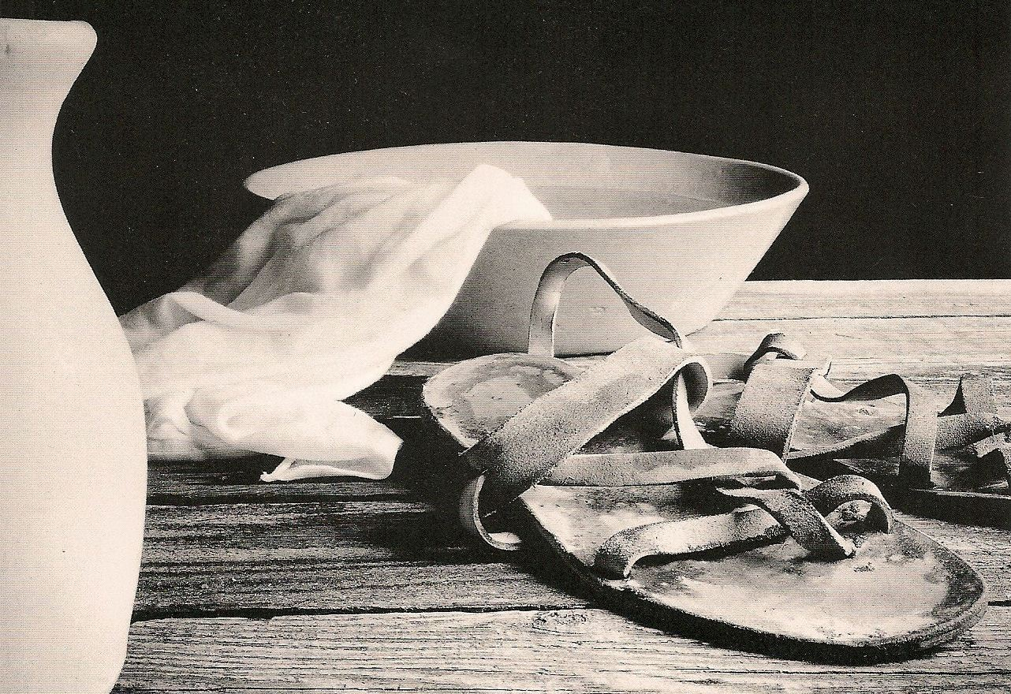
Towel Bearers Find Fulfillment
In being obedient to God
By taking on the Nature of a Servant, Imitating the Divine Nature
In Taking Time to Serve
In Pointing People to Jesus
In God’s Promise To Reward Them
Reflecting and sharing God’s Love and Light
Notes:
Sixth, servant towel bearers understand the difference between good intentions and action. Uzzah probably had good intentions in 2 Samuel 6, but it was the wrong action. In Samuel 15, King Saul spared sheep to sacrifice, but he should have destroyed in obedience. Often, we may have good intentions but fail to follow to action or the right action. Further, we can overlook many in need. American society is full of disconnected people – frequently lonely. Yes, they have social media “friends” and such, but Americans are the most connected disconnected people in history. Jon Bloom expressed it this way, “Since the fall of man, people had trouble staying focused, but today in an age of unprecedented distraction, lots of experts are talking about the negative effects this is having on us. Many of us feel it: the buzzing brain, the attention atrophy, the diminishing tolerance for reading, especially books. We’re becoming conditioned to distraction, and its’s harming our ability to listen and think carefully, to be still, to pray, and to meditate. Which means it is a spiritual danger.” Servant towel bearers not only intend to serve, but they complete the action and seek to recognize opportunities.

Slide 20
Is Your Servant Towel Huge and Well Used?
Notes:
Conclusion
“IS YOUR SERVANT TOWEL HUGE AND WELL USED?” The servant towel bearer finds fulfillment in obeying God. The towel bearer finds fulfillment in taking time to serve others and enjoys the role of servant in imitating Jesus. Knowing God's promises, the towel bearer finds fulfillment in sharing God's light and pointing others to the Lord. The children of light must make sure their servant towels are huge and well used. Service, as a form of love in the name of God is something everyone can see and understand, even the blind. Christians are to shine as lights when doing good works to glorify their Father.

